Slide 1
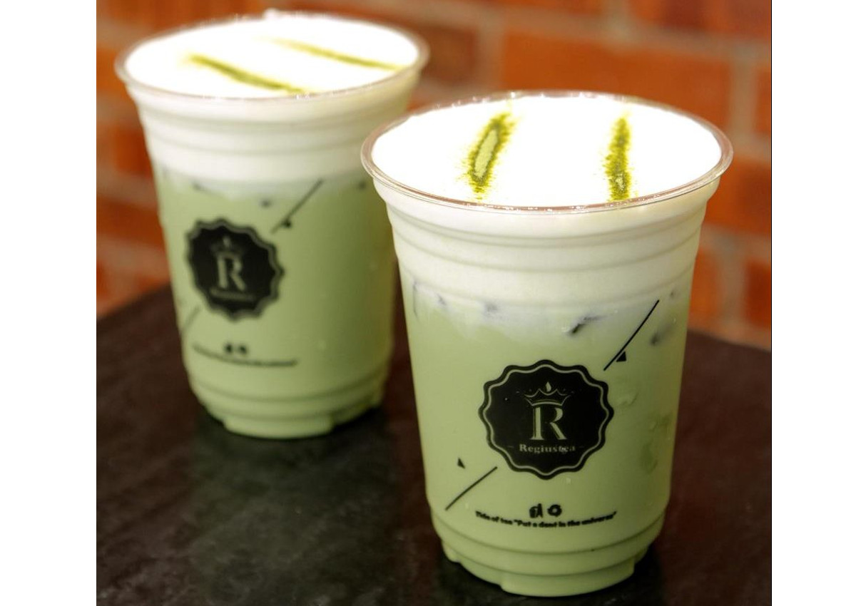
Cheese tea is a new trend in China

Slide 2
A little dog with appealing big brown eyes

Slide 3
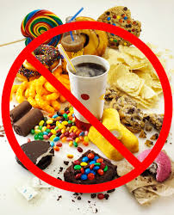
If you are on a diet, you should avoid eating junk food

Slide 4
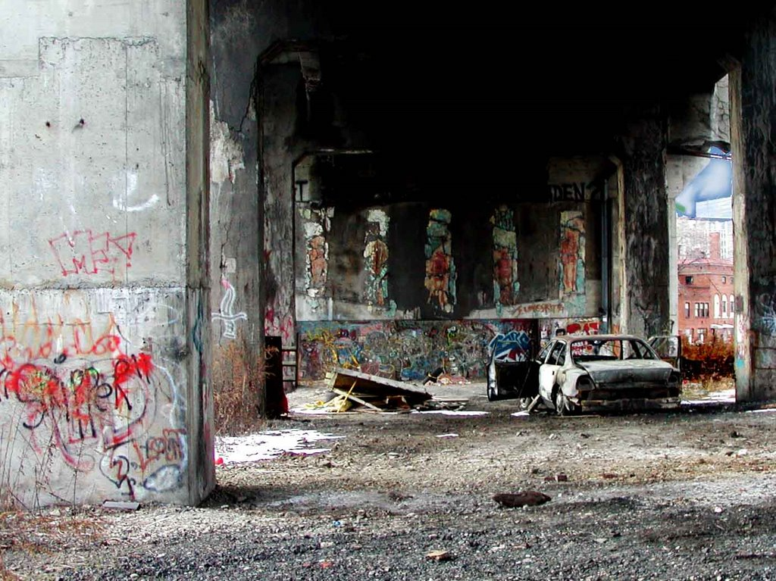
A slum area in the U.S.A

Slide 5
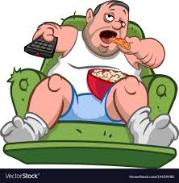
It is ironic that the health teacher ‘s son is a non sporty guy

Slide 6
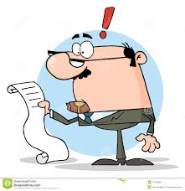
Some people resent (z) the fact that the tip is included in the bill.

Slide 7
In France , the yellow jackets protest against the French Government.

Slide 8
He moves in rhythm with the music.

Slide 9
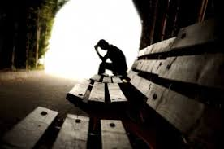
His face bears his hopelessness or he feels hopeless.

Slide 10
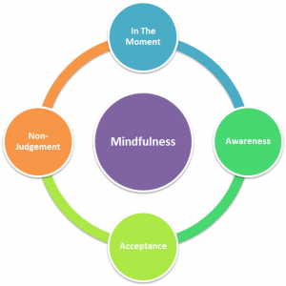
Self-awareness is a state of being that is achieved when you deeply understand your own thoughts, emotions and behaviors.

Slide 11
Vocabulary
Trend-מגמה
Appealing-מושך
Avoid-להתחמק
Slum area-אזור שכונת עוני
Ironically-באופן אירוני
Resent-להתרעם
Protest-למחות
Rhythm-קצב
Hopelessness-חוסר תקווה
Self-awareness-מודעות עצמית

