Slide 1
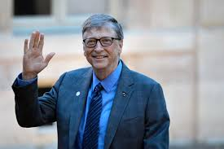
11 things you will NOT learn at school
Bill Gates`s speech at an American High School

Slide 2
Love him or hate him, he is one of the most successful men in the world.

Slide 3
Who is he?
Occupation: Business magnate, investor, author, programmer, philanthropist, humanitarian.
Known for: Principal founder of Microsoft
Net worth: US$100 billion (April 2019)
Meaning….100 000 000 000 $

Slide 4
BILL GATES
Bill Gates gave a speech at a High School about 11 things they did not and will not learn in school.
He talks about how “feel-good”, politically correct, teaching created a generation of kids with no concept of reality…
…and how this concept set them up for failure in the real world.

Slide 5
In other words…
He speaks about rules which you are about to face in real life. He wants you to be prepared and change your attitude to learning while you can.

Slide 6
Rule 1
Life is not fair - get used to it!
Not everyone will be fair to you just because they should. See what you can do to earn good and fair attitude.

Slide 7
Rule 2
The world won't care about your self-esteem. The world will expect you to accomplish something BEFORE you feel good about yourself.
The world doesn’t` care that you don`t feel good right now. They will want you to do things before you feel good. They will not wait.

Slide 8
Rule 3
You will NOT make $60,000 a year right out of high school. You won't be a vice-president with a nice car and house until you earn both.

Slide 9
Rule 4
As a boss you will probably want more from your employees than just their nice personality and all their weaknesses to accept.
If you think your teacher is tough, wait till you get a boss.

Slide 10
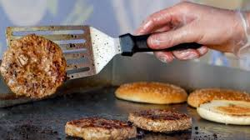
Rule 5
Any work is good enough to get experience. Even if it is cleaning or being a waiter in a café.
Flipping burgers is not beneath your dignity. Your grandparents had a different word for burger flipping: they called it “opportunity”.

Slide 11
Rule 6
If you mess up, it's not your parents' or your teachers` fault, so don't whine about your mistakes, learn from them.

Slide 12
Rule 7
Before you were born, your parents weren't as boring as they are now.
They got that way from paying your bills, cleaning your clothes and listening to you talk about how cool you thought you were.
So before you judge them, try cleaning the closet in your own room (on a regular basis).

Slide 13
Rule 8
Your school may have done away with winners and losers, but life HAS NOT.
In some schools, they have abolished failing grades and they'll give you as MANY TIMES as you want to get the right answer.
This doesn't bear the slightest resemblance to ANYTHING in real life.

Slide 14
This means:
You school doesn`t allow to divide students into “winners” and “losers”. You don`t have failing grades. You can`t be expelled from school. You are given chances for the 2nd try (and more!) until you come up with correct answer.
Well… NOT in life.

Slide 15
Rule 9
People in real life will not give time or help you to find yourself. Do it now and stick to it.
Life is not divided into semesters. You don't get summers off and very few employers are interested in helping you FIND YOURSELF.
Do that on your own time.

Slide 16
Rule 10
Television is NOT real life. In real life people actually have to leave the coffee shop and go to jobs.

Slide 17
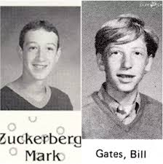
Rule 11
Be nice to nerds. Chances are you'll end up working for one of them.

Slide 18
Not me… I wasn`t the one who taught you how to read…

