Slide 1
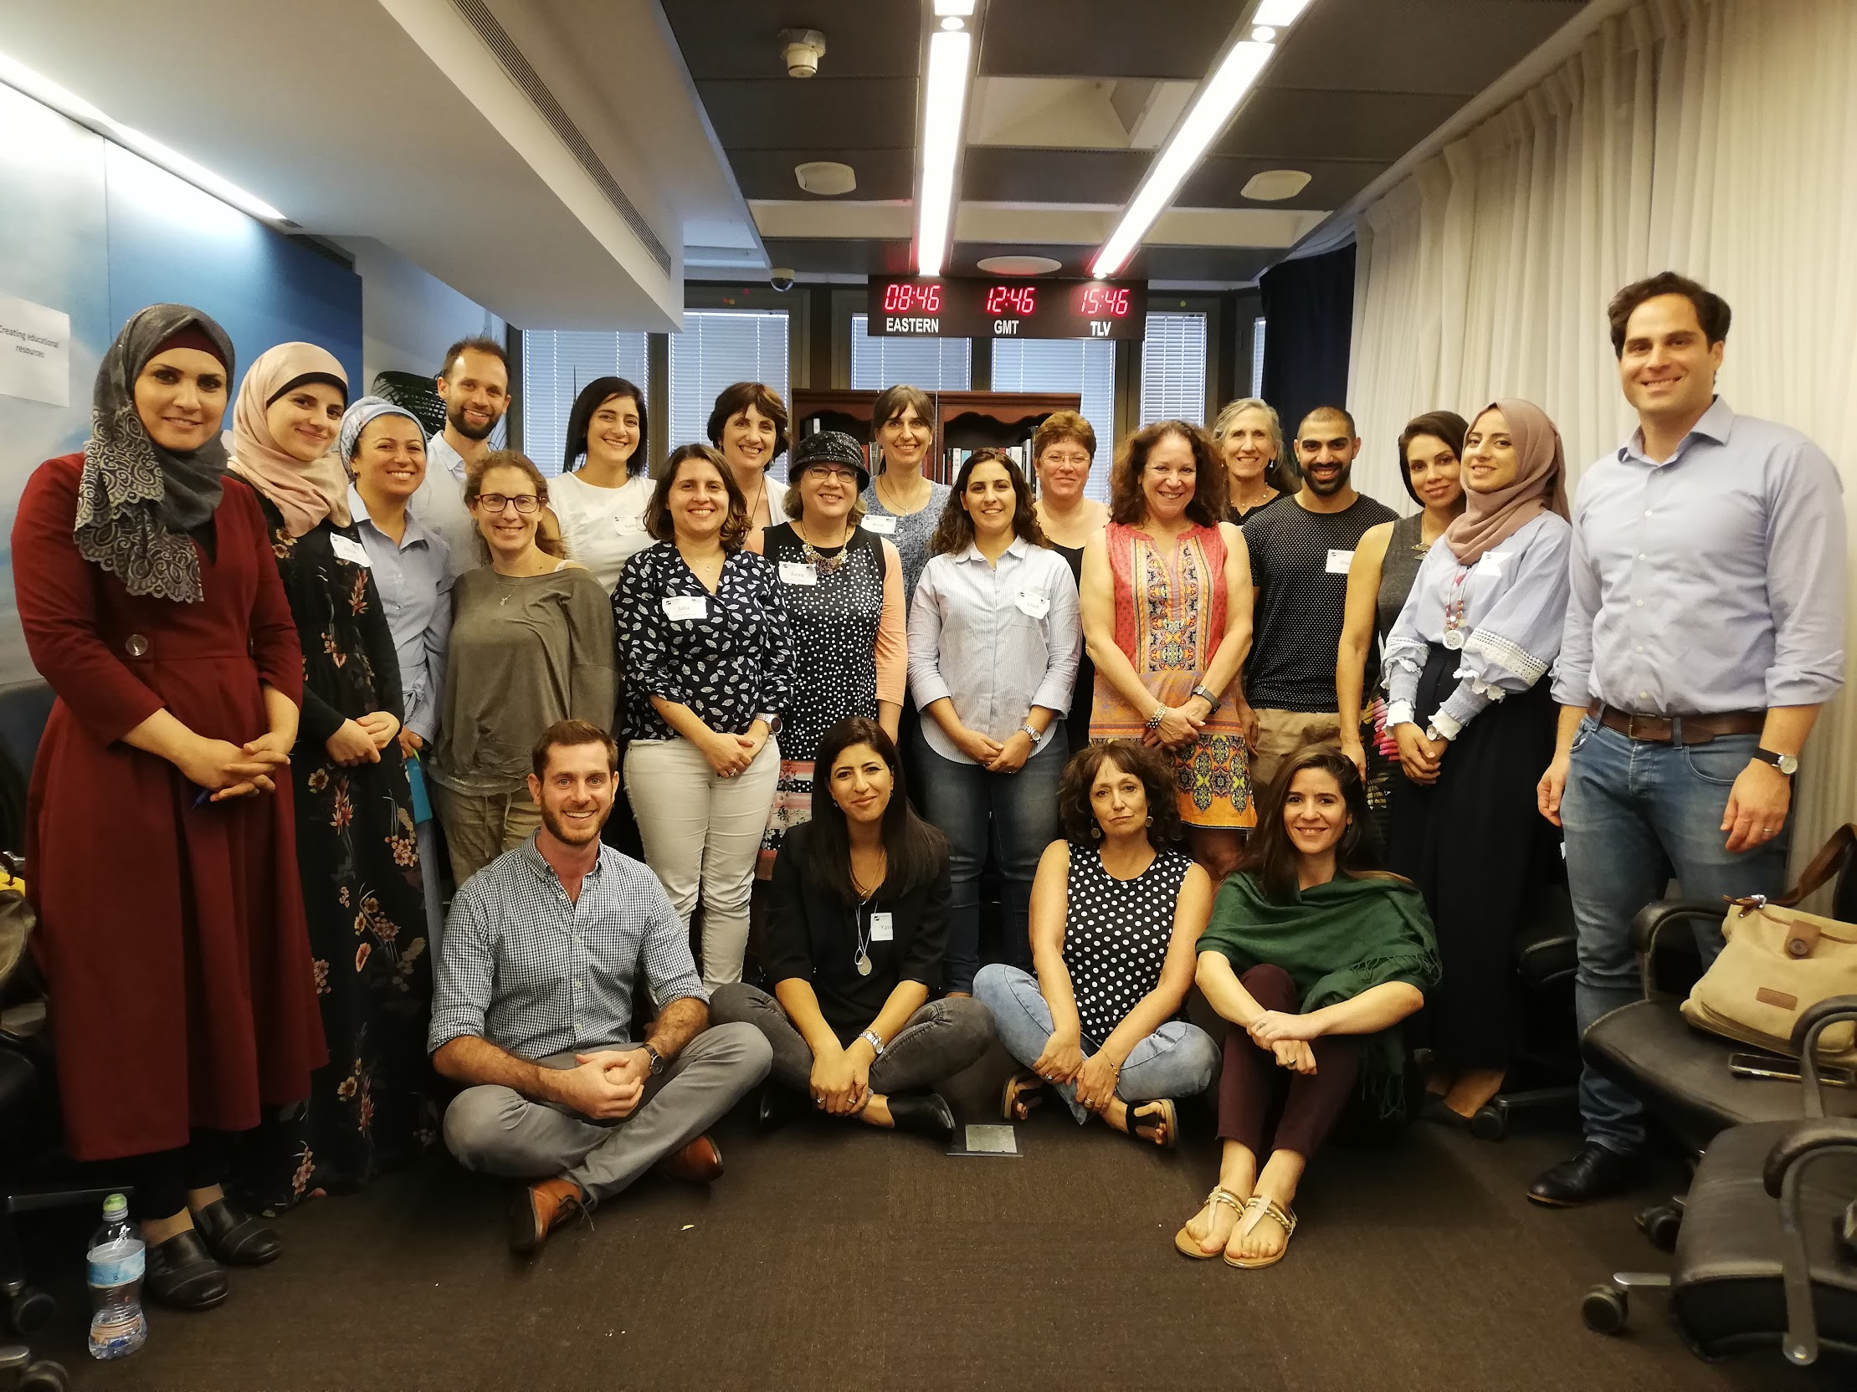

Slide 2
2018-2019 NET Fellowship
Oct 23 Nov 28 Dec – Mar Apr 11 June 12
Fellowship Launch
Educator Workshop 1: Foundational Concepts
Student Game Changers Workshops
Educator Workshop 2: Teaching Activities
Year End Celebration
Fellowship Community
Site Visits before student workshops
Teaching activity creation coaching – video calls
3 webinars with Harvard experts (from home)
Active observation
Creation and testing of teaching activities
Reflection
Resource Library
Evaluation & Assessment
Questionnaires with Fellows and Students, and focus group with Fellows at conclusion of program

Slide 3
Agenda
Welcome
Opening Exercise
Negotiation Concepts & Facilitative Teaching Methods
Adapting Games for Learning Negotiation Concepts
Writing and Running Role Play Activities
Developing Inter-School Partnerships
Activity creation lab
Closing

Slide 4
Agree? Disagree?
Y
N
Examples:
Students should wear school uniforms
Teachers and principals should not have access to cell phones during class time
I have used negotiation techniques in my own life since starting the PATHWAYS Fellowship.
Understanding positions & interests can solve any conflict

Slide 5
Negotiating for Building Speaking Skills
Motivation of wanting to achieve or get something
Dynamic practice of communication and negotiation skills
Spontaneous production and response
Vocabulary, phrases, stems
Asking, sharing (or concealing), reframing, framing
Clarifying, paraphrasing, confirming understanding
Improvising, reacting to surprises
Naturally incorporating HOTS
Normal psychological pressure of interacting with another person (who has their own perspective, wants and concerns)
Play

Slide 6
Negotiation Concepts & Pedagogical Methods
Impact
Enthusiasm
Notes:
Memory activity if you’re building off of previous concepts – different ways for them to think differently and interact with the work space rather than just raising their hands.

Slide 7
Adapting Games: Positions & Interests
Positions are the demands that people typically make and are what it is often most apparent to us.
Shared
Different
Competing
Interests are the reasons, concerns and goals that lie beneath. There are usually many interests beneath a position.

Slide 8
Scenario:
11th grade student wants to apply for an elite soccer camp that would qualify you for a unique job at the summer camp. You would need to miss 2 weeks of school.
Parent of 11th grade student is negotiating with her/his child about an elite summer camp, which would cause him/her to miss 2 weeks of school at the start of the most important year in high school.
Negotiation Walk Instructions:
Goal: to take steps and meet in the middle
-Stand facing your partner, about half a room apart.
-You will begin negotiating, taking turns. Each turn consists of one of the sides trying to further the negotiation and solve the problem. -Each time your partner asks or inquires about something that you feel is relevant and constructive to your interests, tell him/her to take ONE step forward.
-If your partner offers comments or questions that are against your interests, tell him/her to take TWO steps backward.

Slide 9
Short Role Plays
How would you adjust this role play to practice problem-solving negotiation skills?
Source: BBC

Slide 10
Adapting Games, continued: Options
Your friend, Christopher, is coming for a visit from Germany. He is going to stay at your house during the visit. You agreed that you’ll pick him up from the train station upon his arrival. His train is scheduled to arrive at 16:30. You made plans to leave work early to be at the train station by 16:30. It’s 16:45 and you haven’t found Christopher in the crowd yet. You know that he was on that train and that the train arrived on time, but where could he be? You must have missed him among the hundreds of people at the crowded train station. You reach into your pocket for your phone to contact Christopher, only to discover that you have forgotten your phone at the office. Christopher doesn’t have your home address, it’s his first time in Israel and you’ve promised to pick him up.
What are you going to do? How will you find him at the train station?

Slide 11
Teaching Activities
Descriptive Title
Learning Objectives
Time required
Lead-in/Prep
Materials required, if any
Activity instructions
Assessment
Reflection

Slide 12
Composing Role Plays
A clear set of objectives / resolution (“interests” – S/D/C)
Examples of Questions
A complication that prompts thinking
Examples of pragmatic skills: opening/closing, turn taking, interrupting, changing topic, etc.
A language function with example phrases: complain, request, apologize, invite, advise, greet, accept, refuse, warn, compliment, suggest, advise)
Thanks to Roger Cohen, RELO
Notes:
Mike’s slide

Slide 13
Gmul Hishtalmut: Grading
 | Great | Good | Needs Improvement | Weight
Teaching Activity Creation & Testing Creation of two original teaching activities that integrate concepts of problem-solving negotiation into E.L. curriculum | Creation of 2 complete, original teaching activities and refinement based on experimentation 50 | Creation of 2 complete, original teaching activities 40 | Creation of 1 complete, original teaching activity 30 | 50%
Reflection and Lessons: Teaching Activity Creation and Use How did the activity go? What worked well? What should be adjusted? | In-depth and meaningful reflection 25 | Reflection shows some insight 20 | Reflection lacks insight 15 | 25%
Personal Reflection What concepts were most relevant to you in this program? What did you learn? What would you like to apply going forward and how? | In-depth and meaningful reflection 25 | Reflection shows some insight 20 | Reflection lacks insight 15 | 25%
 |  |  | Final Grade
** Compulsory – at least 80% attendance in all sessions, workshops and webinars
Notes:
Mike

Slide 14
2018-2019 NET Fellowship
Oct 23 Nov 28 Dec – Mar Apr 11 June 12
Fellowship Launch
Educator Workshop 1: Foundational Concepts
Student Game Changers Workshops
Educator Workshop 2: Teaching Activities
Year End Celebration
Fellowship Community
Site Visits before student workshops
Teaching activity creation coaching – video calls
3 webinars with Harvard experts (from home)
Active observation
Creation and testing of teaching activities
Reflection
Resource Library
Evaluation & Assessment
Questionnaires with Fellows and Students, and focus group with Fellows at conclusion of program

Slide 16
Contact Us
rachel@pathwaysnegotiation.org
michael@pathwaysnegotiation.org
avi@pathwaysnegotiation.org

